Slide 1
UoSM Robotics Club 2018
1ST CLASS OF ARDUINO MODULE

Slide 2
Introduction: What is Arduino?
Arduino is an open-source electronics software.
It is built for artists, designer, hobbyists and people who love designing and creating interactive objects!
It was founded in the Interaction Design Institute Ivrea (IDII) in Ivrea, Italy.
Similarly, in our case, we use it for programming.

Slide 3

What is Arduino?
The official logo of Arduino

Slide 4
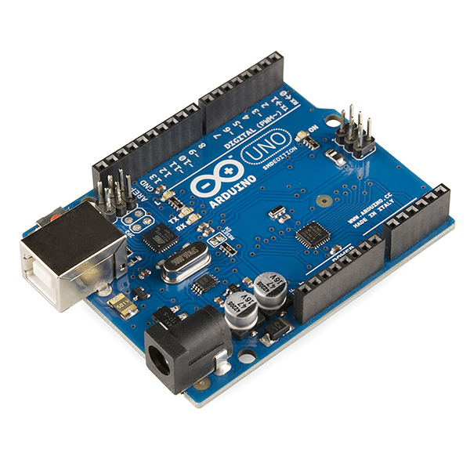
Arduino microcontroller
In learning to use Arduino, we will each be using a Maker UNO module. The module shown below is an Arduino Uno Module R3.
It is a programmable circuit board and it utilizes a much simpler version of the dreaded C++ programming language.

Slide 5
What we are going to use today!
We will be using a Maker Uno by Cytron!
Nearly the same with a Maker Uno except the fact that it comes with buzzers and built in LED’s
However, there are some limitations(very few) with the Maker Uno.
Some simple spec differences will be covered in the next slide.

Slide 6
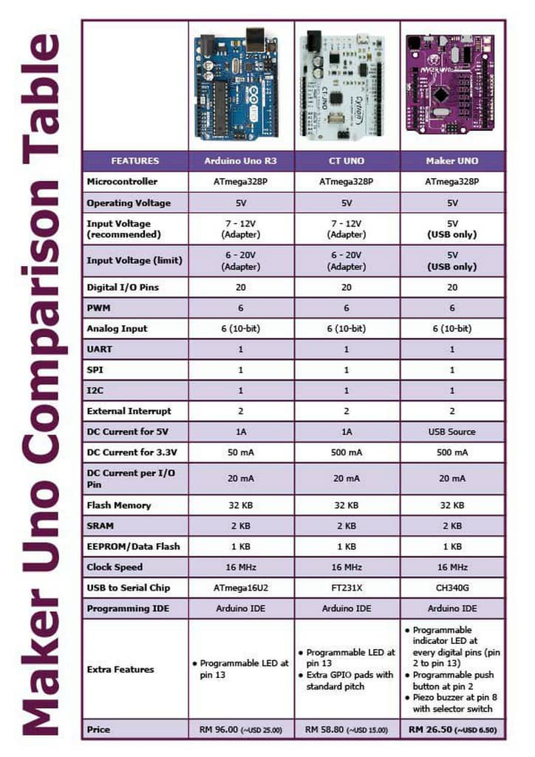
Some differences…

Slide 7
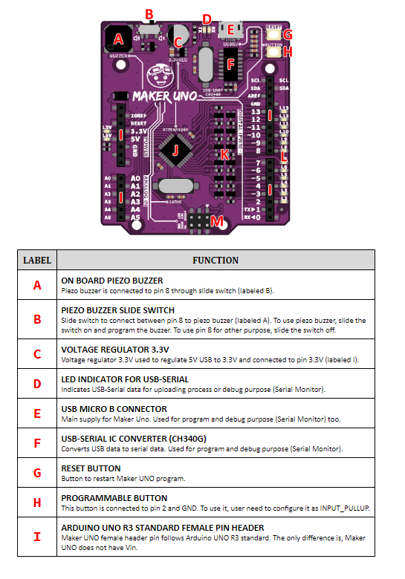
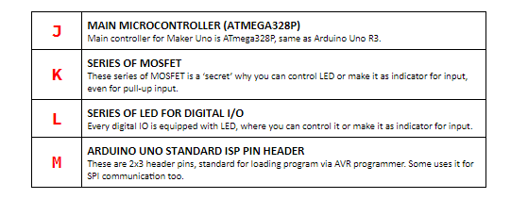
Maker Uno Diagram…

Slide 8
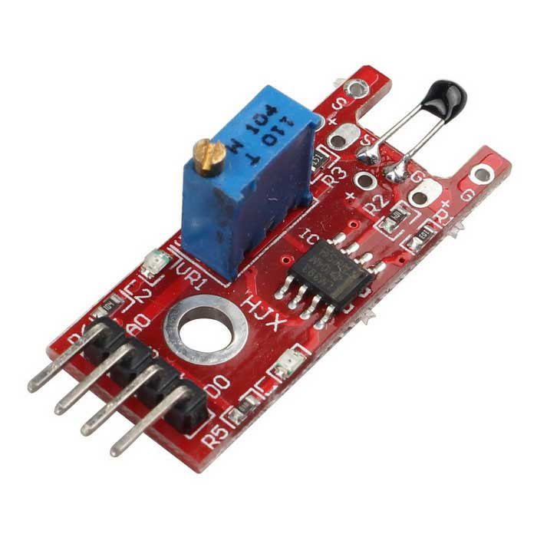
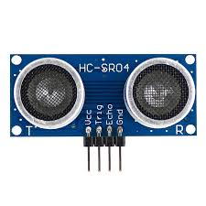
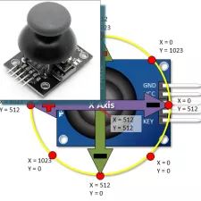
Arduino input sensors
Arduino Inputs Sensors range from temperature sensors, ultrasonic sensors, voltage sensors and a variety of switches. In fact, what makes it interesting is that you can even use PS2 analog sticks as controlling devices in Arduino!

Slide 9
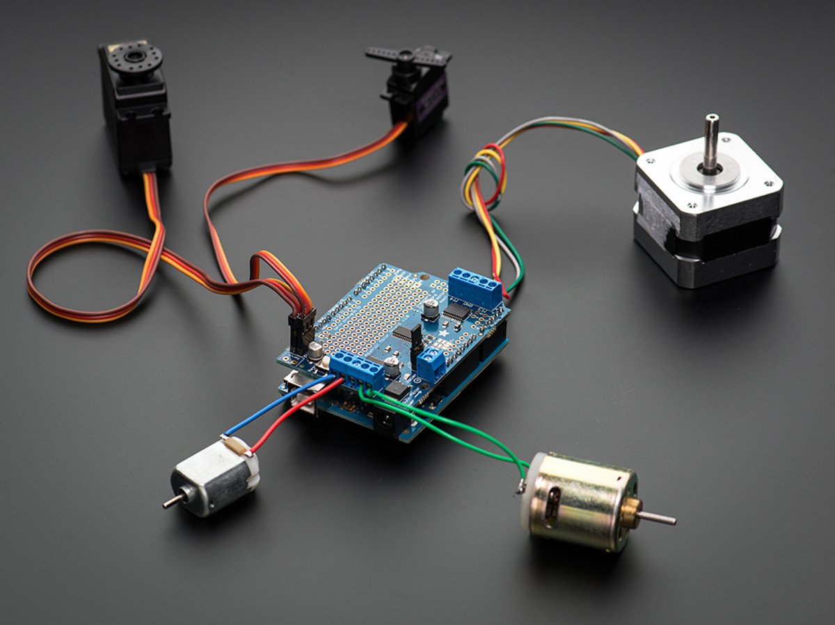
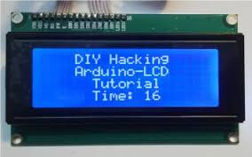
Arduino output devices
In Arduino, having input devices alone will not help us accomplish anything if the robots or devices built have no output devices. So, a few examples of output devices used in Arduino include a display screen, light or a motor.

Slide 10

Beginning…
Now let us start! In your groups, start off by unboxing the maker uno and familiarize yourselves with it. Further instructions will be provided
Please handle them carefully and responsibly.

Slide 11
Downloading the Arduino software
On your laptops, go to www.arduino.cc.
On the menu bar at the top of the page, click the “Software” button.
On that page, download the latest version of Arduino which is Ver 1.8.5. according to the compatibility of the operating system of your device.
Install the program and run it when installation is complete.
Download the CH341 driver and install it onto your computer.
Further instructions will be given.

Slide 12
References
http://forefront.io/a/beginners-guide-to-arduino/
https://www.arduino.cc/en/Main/Software

